Slide 1
Hydrogen Pipeline Systems - Code of Practice
Chapter 10 Composite pipeline materials

Slide 2
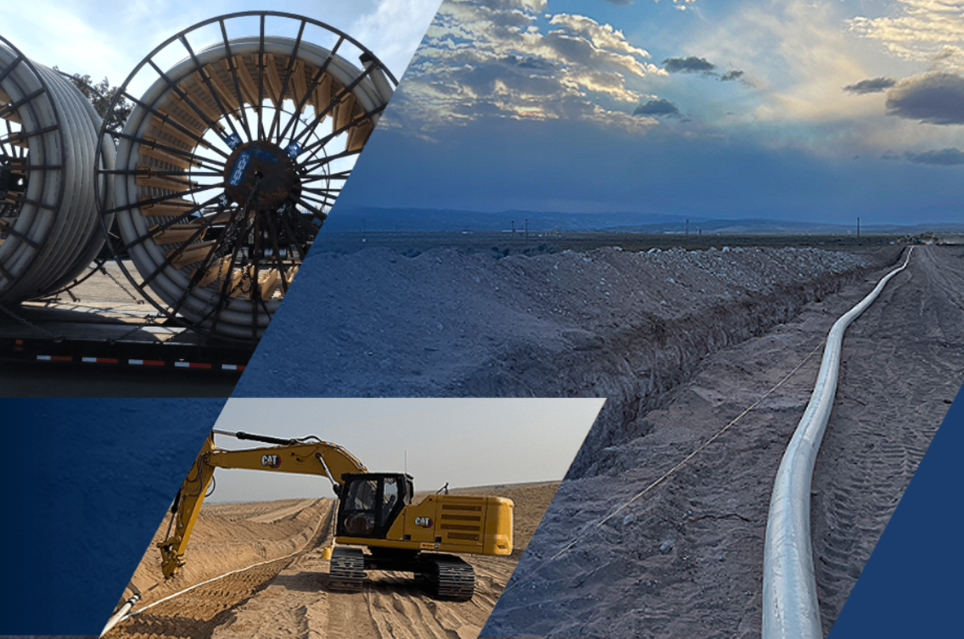
Composite Pipelines
Are not sensitive to Hydrogen concentration including 100% Hydrogen (except where steel reinforced).
Can provide an alternative to steel pipes.
Are typically highly resistant to corrosion
Can be cheaper and quicker to manufacture, deliver, install and operate (for certain size ranges).
The total carbon footprint for a composite pipeline may be as low as 33% of that of an equivalent steel pipeline.
Composite pipes are available in a wide range of materials and are manufactured in a wide range of configurations.
Can be subject to accelerated loss of strength in cyclic service

Slide 3
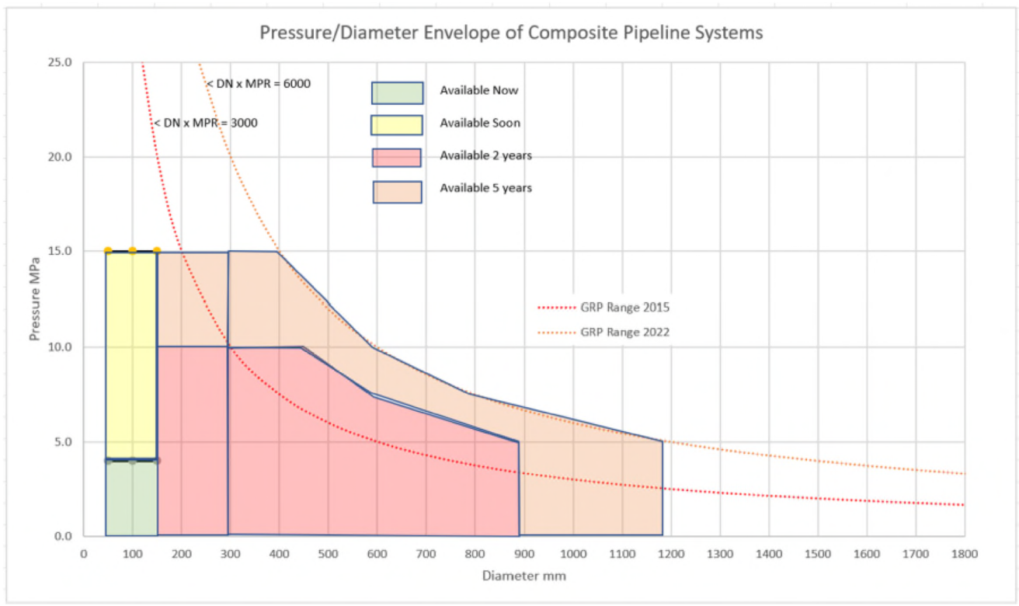
Composite pipeline range for H2
In 2025 the sizes and pressures predicted in this chart are now becoming available

Slide 4
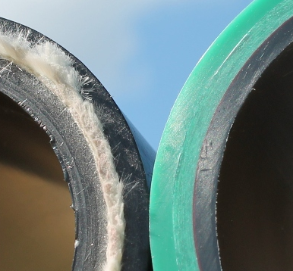
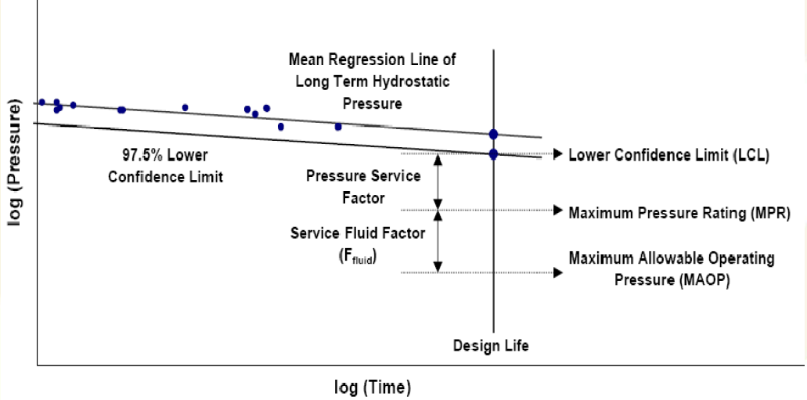
FRP design methodology
Couplings and joints able to transfer load between adjacent pipes (i.e. no sliding o-ring joints)
Design to operate below the initial damage threshold (micro-cracks are a precursor to leaking)
Assess loss of strength (regression) with extended loading time
Design life 20 years, 50 years or 100 years achievable but strength at end points requires to be understood
Performance based design with properties proven directly by testing
Qualified by testing under 2:1 load (pressure only) and R:1 combined load (pressure plus axial and bending).
For larger projects re-validation testing of project pipes is possible
NOTE: This utilizes some methods from the next edition of ISO 14692–20xx

Slide 5
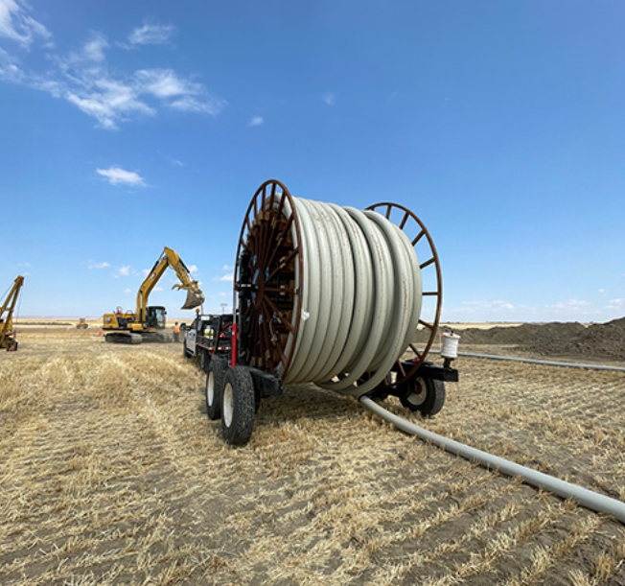
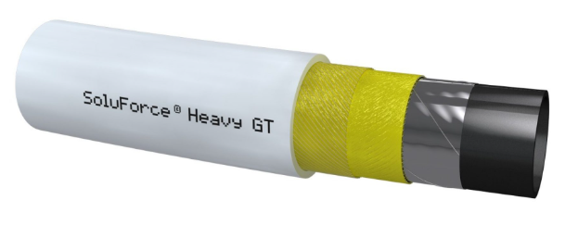
H2 Permeation
H2 will permeate through all pipe materials and leak at all joints.
Possible loss of product, explosion risk, asphyxiation (e.g. manholes)
Barriers (e.g. Al foil, high tech thermoplastic film) can be included in composite pipes reducing permeation rates to insignificant.
Poor data quality makes a definitive assessment difficult but the following is indicative (1 km, DN 300 at 10 Mpa);
X70 pipe 0.45 Sm3/day
HDPE reinforced 18.3 Sm3/day
HDPE with Al barrier 0.0002 Sm3/day
GRE pipe 0.22 Sm3/day
GRE with film barrier 0.02 Sm3/day

Slide 6
Issues to be managed
Materials compatibility (e.g. steel wire reinforcement, steel couplings)
For fibreglass designs based in ASTM D2992 ‘regression’ must be replaced with ‘threshold, methods.
BVID (barely vidible impact damage) must be avoided during construction by appropriate handling
Rapid decompression testing must be undertaken
Cyclic capacity may require additional testing to verify strength regression
Third party validation of design and manufacture (available) may be appropriate.
Location of permeation and leak rates should be assessed
Resistance to penetration by mechanical equipment is low so full bore rupture must be considered (running fracture is typically not possible)
Additional third party protective measures will be necessary where risks are not negligible (e.g. cable in marker tape, fences, slabs, ROW intrusion detection (smart fibre optic), signage, liason, patrols.

