Slide 1
Chapter 7 Welding
Mehdi Fardi (ROSEN)

Slide 2
Overview
1- Welding Code/Standard, Technique, consumables, WPS and PQR
2- Hardness limits
3- In-Service Welding
4- Girth Weld Defect Acceptance Criteria

Slide 3
Pipeline Girth Welds
Probably the least researched topic in Hydrogen pipeline subject
Main questions:
What welding Code/Standard can be used?
Is there any change to the current essential variables?
What is the Hardness limit?
What additional requirements apply to In-service welds?
What is the preferred NDT technique?
Are the existing defect acceptance criteria still valid?

Slide 4
Welding Code, Technique, WPS, PQR etc.
AS 2885.2 and API 1104 are still valid but:
More stringent hardness limits apply
Some additional limits may apply to the current essential variables
Project specific girth weld defect acceptance criteria need to be established through Engineering Critical Assessment (ECA)
Material toughness testing in Hydrogen must be performed as part of PQR (significant time and cost)

Slide 5
Hardness testing and limits
There is a clear link between high hardness and Hydrogen Embrittlement so hardness must be limited!
AS 2885.2 specifies 350 HV for non-sour service and 250 HV for sour service pipelines
PRCI CERs (bridging document to new ASME B31.8) permits 275 HV. Hydrogen CoP has adopted the sour service limit i.e., 250 HV until more research is conducted.
ASME B31.12 requires hardness testing for PQR and production but CERs have removed the production weld hardness testing.

Slide 6
In-service welding
There are three key considerations:
Elevated inside wall temperatures leads to accelerated uptake of hydrogen into the steel during welding, which may increase the risk of HACC.
The flowing contents of the pipeline removes heat from the pipe wall which results in higher cooling rates (compared to production welding) which can lead to the formation of crack-susceptible microstructures which are of greater concern in pipelines intended for hydrogen service.
Increased concentrations of hydrogen in the pipe wall from prolonged service in a hydrogen environment leading to accelerated crack growth and failure at smaller defect size.

Slide 7
In-service welding
Thin-walled pipelines (wall thickness <7.1mm) result in higher internal surface temperature from reduced heat sink effect and higher through-wall heat transfer. (refer to IPC2022-87202)
The observed higher increases in weld hydrogen levels increases hydrogen diffusion into the weld area during in-service welding onto hydrogen pipelines may increase the risk of crack-like defects forming from HACC.
Weld procedures should consider reducing heat input such that the maximum inside surface temperature remains below the austenite transformation temperature of 723°C.

Slide 8
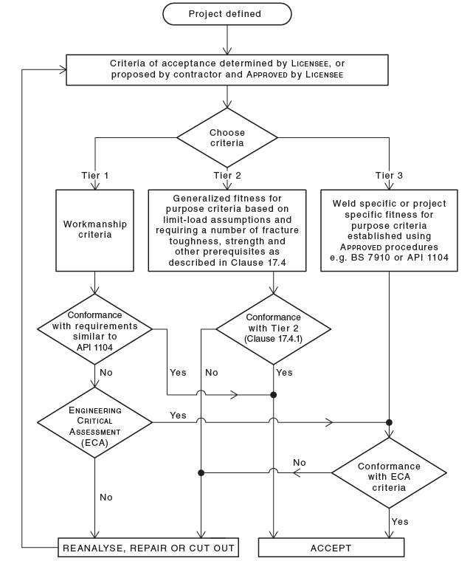
Defect Acceptance Criteria
AS 2885.2 presents three weld defect acceptance criteria (Tier 1, Tier 2 and Tier 3).
Tier 1 is widely used in the industry. Tier 2 and Tier 3 were developed to allow for larger defects and reduce repair rate.
Tier 1 does not require any analysis or assessment (workmanship criteria)
Tier 1 does not apply to pipelines under cyclic operation (even for natural gas) unless fatigue analysis is performed.

Slide 9
Defect Acceptance Criteria
Tier 1 may not be valid for Hydrogen pipelines without Engineering Critical Assessment (ECA)
Tier 1 is not valid for Hydrogen pipelines under any cyclic condition.
Tier 3 is based on Engineering Critical Assessment (ECA) which requires specialized skill (fracture mechanics and fatigue), tool and material properties.
ECA is generally performed to BS 7910 or API 579-1
The goal of ECA is to determine the acceptable defect size at “Construction”.

Slide 10
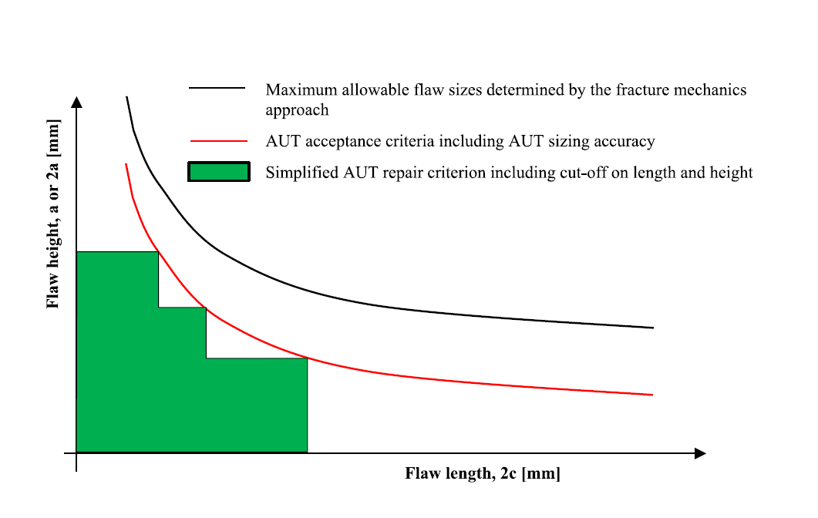
Defect Acceptance Criteria
ECA starts with an initial defect size that is grown under cyclic stress until failure.
This defect size forms a basis for the defect acceptance criteria (iterative approach).
The acceptance criteria specifies the initial defect size, but the ECA covers the whole pipeline life even the last day of operation!
The initial defect size used in ECA must account for NDT under sizing error.

Slide 11
Defect Acceptance Criteria
Deterministic ECA assumes the worst-case value for all input data e.g., strength, toughness, misalignments etc. (all holes of Swiss cheese are aligned).
Probabilistic ECA is not very common (even for offshore and sour service pipelines) and requires comprehensive statistical data for every variable.
Probabilistic ECA requires special tool/software and can be very time consuming to perform.
Probabilistic ECA requires an acceptable Probability of Failure (POF). Different countries/jurisdictions can have different acceptable POF and some countries don’t even allow probabilistic analysis.

Slide 12
Defect Acceptance Criteria
Challenges:
Combined effect of Hydrogen Embrittlement (HE) and Hydrogen Accelerated Fatigue Crack Growth Rate (HA-FCGR) significantly affect the defect acceptance criteria and construction.
Both HE and HA-FCGR are more aggressive in Hydrogen environment than sour service, so experience is not necessarily transferable to H2.
Established ECA methodologies used in offshore and/or sour service pipelines e.g., DNV-RP-F108 can be either too conservative or not conservative at all (require comprehensive validation).

Slide 13
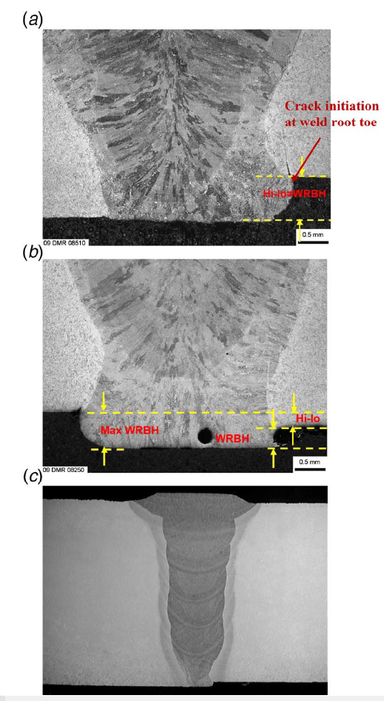
Defect Acceptance Criteria
Weld residual stresses in As-Welded girth welds are quite high (equal or higher than SMYS)
Post Weld Heat Treatment of the girth weld of TMCP pipes is not recommended (reduction of strength and potential increased corrosion risk).
With the common observed toughness values (50-70 MPa.m^0.5), unless the axial/bending static and cyclic stresses are reduced to a very low level, a practical acceptable defect size might not be achievable.
To improve the practicality of the acceptable defect size, Hi-Lo misalignment must be significantly reduced.

