Slide 1
Chapter 3 Physical Properties and Characteristics of Pure Hydrogen and Blends of Hydrogen within Natural Gas
Sam Hatwell (GPA), Marzieh Amanabadi (GPA)

Slide 2
Overview
1- Process Modelling; Hydraulic Simulation and Line Sizing
2- Safety in Design; Release Event Consequence Modelling, Hazardous Area Classification
Notes:
This chapter explains the properties of pure hydrogen and hydrogen-natural gas blends for pipeline transport. It compares hydrogen to methane (as the main component of the NG) to highlight key differences affecting pipeline design and operation. It covers process…

Slide 3
Properties of Methane, Hydrogen and 10 %H2 Blends
Parameter | 100%CH4 | 10%H2 / 90%CH4 | 100%H2
Molecular Weight [g/mol] | 16.042 | 14.639 | 2.016
Standard Density [kg/Sm3] | 0.6785 | 0.6191 | 0.0853
Specific Gravity Relative to Air | 0.554 | 0.505 | 0.070
Joule Thomson Coefficient | Positive | Positive | Negative
NG = -0.5 °C per 100 kPa pressure drop
(depends on the fluid composition - it could be from -0.3°C to -0.5 °C)
H2 = +0.04 °C per 100 kPa pressure drop.
Notes:
H2 MW as well as its density is 1/8 of NG MW and density. H2 is more buoyant and dispersed more when released, which is beneficial for gas leaks but requires caution in enclosed spaces to prevent accumulation. H2 moves faster and therefore it has higher sonic velocity, over 1,300 m/s at standard conditions, which is significantly higher than that of natural gas, which is around 400 m/s.
The Joule-Thomson (JT) coefficient for H₂ is negative, resulting in unique behavior compared to other gases during the JT effect. The Joule-Thompson coefficient relates the temperature change of a gas to the decrease in pressure when it undergoes an isenthalpic expansion.

Slide 4
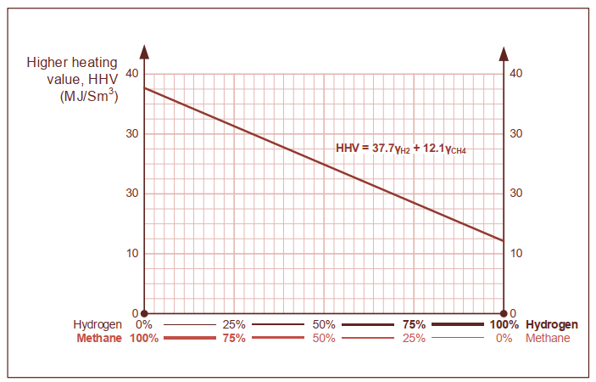
Properties of Methane, Hydrogen and 10 %H2 Blends
Parameter | 100%CH4 | 10%H2 / 90%CH4 | 100%H2
Higher Heating Value [MJ/Sm3] | 37.71 | 35.15 | 12.10
WI | 50.67 | 49.44 | 45.87
The Wobbe Index affects burner performance and may introduce safety risks like flameout or light-back. Changes in the Wobbe Index can affect gas appliance performance, leading to safety issues. When converting to hydrogen or blends, systems with appliances may need assessment or replacement.
Notes:
Hydrogen’s HHV is one-third of natural gas, so transporting the same energy requires three times the volumetric flow rate.
Hydrogen’s WI is less than the NG.

Slide 5
Properties of Methane, Hydrogen and 10 %H2 Blends
Parameter | 100%CH4 | 10%H2 / 90%CH4 | 100%H2
Auto Ignition Temperature [°C] | 600 | 560 to 600 | 560
Hazardous Area Temperature Class | T1 | T1 | T1
Lower Flammability Limit [vol%] | 4.4 | 4.4 | 4.0
Upper Flammability Limit [vol%] | 17.0 | 18.4 | 77.0
Hazardous Area Equipment Group | IIA | IIB | IIC
Notes:
Hydrogen has slightly lower auto-ignition temperature. H2 and NG both fall in Temperature Class T1 as per AS/NZS 80079.20.1:2019.
Hydrogen (H2) is typically classified under equipment group IIC which is for more hazradouse gases with wider range of flamibility and lower ignition energy, while natural gas (NG) is generally classified under equipment group II A with more limited explosion risk.

Slide 6
Equation of State (EOS)
Reliable data for pure hydrogen is provided by the National Institute of Standards and Technology’s (NIST), offering valuable resources for testing and validating other models.
PR EOS is suitable for NG
RKMC is suitable for Hydrogen and Hydrogen blend
MBWR is suitable for pure H2
Notes:
To design hydrogen gas pipelines, we need a detailed and accurate understanding of the gas's thermodynamic properties. It means that we need an accurate EOS.

Slide 7
Properties of H2 Compared to NG
Characteristics of Gaseous Hydrogen for Safety Devices and Controls
Flame Colour - Hydrogen flames are nearly invisible in daylight. So existing flame detectors should be checked for effectiveness.
Gas Detection - Hydrogen's small molecular size makes it easy to leak. Sensitive and reliable detection systems required to ensure safety.
Odour- Hydrogen is odourless, suitable odorants are still being developed. Sulfur-based odorants used in natural gas may work for low hydrogen blends.
Fugacity
Hydrogen has a higher fugacity compared to natural gas, which means there will be more absorption of hydrogen into materials like steel when exposed to it.
Notes:
Therefore, the materials used with hydrogen need to be checked and possibly treated to handle higher absorption levels, making sure they stay strong and work well.

Slide 8
Gas Release and Consequence Modelling
Consequence modelling is used to estimate the range of outcomes that may result from a loss of containment event, therefore, informs the degree of protection required for the design and can also inform optimal pipe routing and facility layout.
Five processes may to be analyzed when evaluating the consequences of a flammable gas release:
Release - Hydrogen leaks at about three times the volumetric rate of methane under the same conditions.
Dispersion - Hydrogen disperses more widely than methane, with plumes up to three times larger at high pressures.
Ignition - Hydrogen requires much less energy to ignite than methane, making it more prone to ignition from various sources, including static discharge. It can also self-ignite at high pressures and velocities,
Explosion overpressure - hydrogen has a higher potential for detonation due to its lower ignition energy
Radiation - Hydrogen, though having a higher flow rate than natural gas, typically has a slightly lower energy flow rate, so its radiation hazards are similar to natural gas.
Notes:
Radiation - radiation contour length for H2 pipeline is less than NG

Slide 9
Process Modelling and Pipeline Sizing
Pipeline Design Requirement
Source condition(s) for the fluid – where is the gas provided from, at what supply pressure/temperature/flowrate, what is the composition, and what is the availability
Pipeline length
Required delivery condition, where is the gas being delivered, at what pressure/temperature/flowrate, and with what regularity/reliability
Notes:
To designing a pipeline, we need to have the following information as input data.
These parameters define the pipeline system’s design, including its diameter, maximum pressure limit, and possibly compressor stations if needed

Slide 10
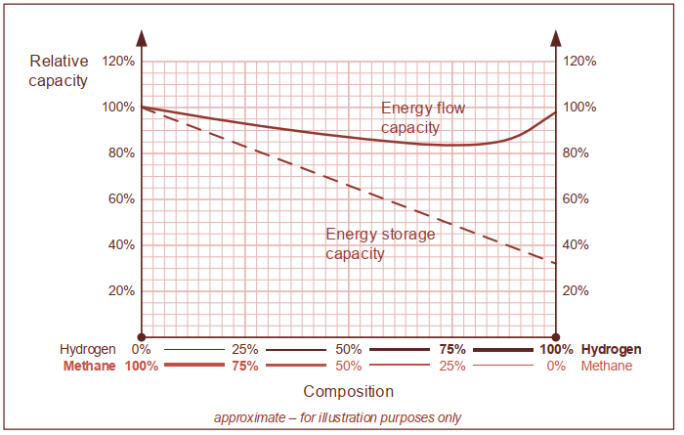
Process Modelling and Pipeline Sizing
Pipeline Capacity
Flow capacity – which is the gas flow rate from the source to the delivery point. In energy terms, a pure hydrogen pipeline will have nearly the same energy flow capacity as a natural gas pipeline for the same operating conditions, while the velocity will be approximately three times higher.
Storage capacity – which is total gas stored between two pressures. A pure hydrogen pipeline has about one-third the storage capacity of a natural gas pipeline under the same conditions. For storage pipelines, fatigue failure (which hydrogen makes worse) may become the most critical design issue.
Notes:
This graph shows the relative reduction in energy storage or flow capacity for hydrogen relative to Methane.

Slide 11
Process Modelling and Pipeline Sizing
Process modelling
Single phase gas fluid
Darcy equation with Colebrook equation to predict friction factor
Maximum Velocity
High flow velocity in pipelines can cause issues, so limits are set to manage this. Hydrogen, being lighter than natural gas, requires higher flow speeds—about 3 times faster—to carry the same energy. For example, if natural gas has a limit of 20 m/s, hydrogen would need about 60 m/s. However, higher speeds can lead to problems like:
Erosion,
Vibration,
Noise, and
Challenges to control the velocity during pipeline pigging.
Notes:
The Darcy equation is widely used to calculate pressure drop in single-phase flow pipelines, with the Colebrook equation commonly used to determine the friction factor.

Slide 12
Process Modelling and Pipeline Sizing
Erosion
High gas velocity can cause erosion inside pipelines due to the interaction between the gas and solid particles. Current methods for assessing erosion risk can still be used for hydrogen. Higher velocities may be used if the pipeline is clean or if further research supports it. The erosional velocity limit shows the H2 erosional velocity is much more than the natural gas at the same condition.
Vibration and Noise
For hydrogen blended into natural gas at low concentrations, the risk of flow and acoustic vibration (FIV and AIV) will be similar to that of pure natural gas.
Pure hydrogen has different characteristics, it has a higher velocity but much lower density, which affects vibration and noise differently.

Slide 13
Process Modelling and Pipeline Sizing
Vibration Risks
Hydrogen's lower density and faster sound speed result in slight turbulence increase, higher resonance frequency, increased vortex shedding frequency, and more noise from pressure let-down devices, while somewhat mitigating vibration coupling risks.
Key Concerns for Hydrogen Pipelines:
Vibration risk from structural resonance: Higher resonance frequencies may cause problems with pipe intrusions (like thermo-wells), so designs need to be assessed.
Increased noise: Pressure reduction devices might cause more noise in hydrogen pipelines, requiring noise control measures.

Slide 14
Process Modelling and Pipeline Sizing
Composition
Hydrogen Impurities
Blended Gas
Equipment and Instrument Sizing
Sizing methods for hydrogen equipment may need adjustments. Existing methods are generally okay if modified for hydrogen's properties, but formulas without molecular weight or specific gravity terms may become inaccurate. Suppliers should offer guidance for their products.
Notes:
The other thing which should pay attention on that is H2 composition. Hydrogen facilities should be designed to manage impurities introduced during production or from upstream process upsets.
For steam methane reforming, impurities may include water, CO₂, CO, and sulphur compounds, which can harm fuel cells.
Electrolysis mainly introduces water and oxygen.
When reusing existing equipment, deposits from past operations may contaminate hydrogen.
The design must ensure both incoming and outgoing gas meet the required specifications.
When designing blended gas facilities, it’s important to consider the blend percentage and how it may vary during process upsets. Both average and extreme compositions should be evaluated, as natural gas properties can already vary significantly. Adding hydrogen, even at 10%, may push parameters like the Wobbe Index out of specification. Gas-fired equipment performance should also be checked. Blending system design is beyond the scope of this guide, but incoming and outgoing gas specifications must be ensured.

Slide 15
Process Modelling and Pipeline Sizing
Pipeline Blowdown / Vent Sizing
Hydrogen pipeline blowdown vents require special design considerations due to the increased risk of ignition. Standard methods can be used, but modifications are necessary for hydrogen's properties. Key requirements include:
Slow-opening vent valves to prevent pressure shocks.
Vent openings should prevent static build-up by having an internal radius or toroidal shape.
Vents must be earthed to prevent static electricity.
Vent release should avoid ignition sources through dispersion calculations.
Personnel should be excluded from radiation and blast zones;
Auto-ignition must be confirmed not to occur either through testing or by providing evidence of safe venting in similar situations.

