Slide 1


University of Wollongong
Research update
RP3.1-12 Gaseous H₂ testing of materials
RP3.2-06 Modern RDF control modelling
Prof Cheng Lu, Dr Bradley Davis,
Dr Rui Wang, Dr Guillaume Michal
Hydrogen Code of Practice Workshop
Melbourne, March 2025

Slide 2
RP3.1-12
Gaseous H₂ testing of representative Australian transmission pipelines

Slide 3
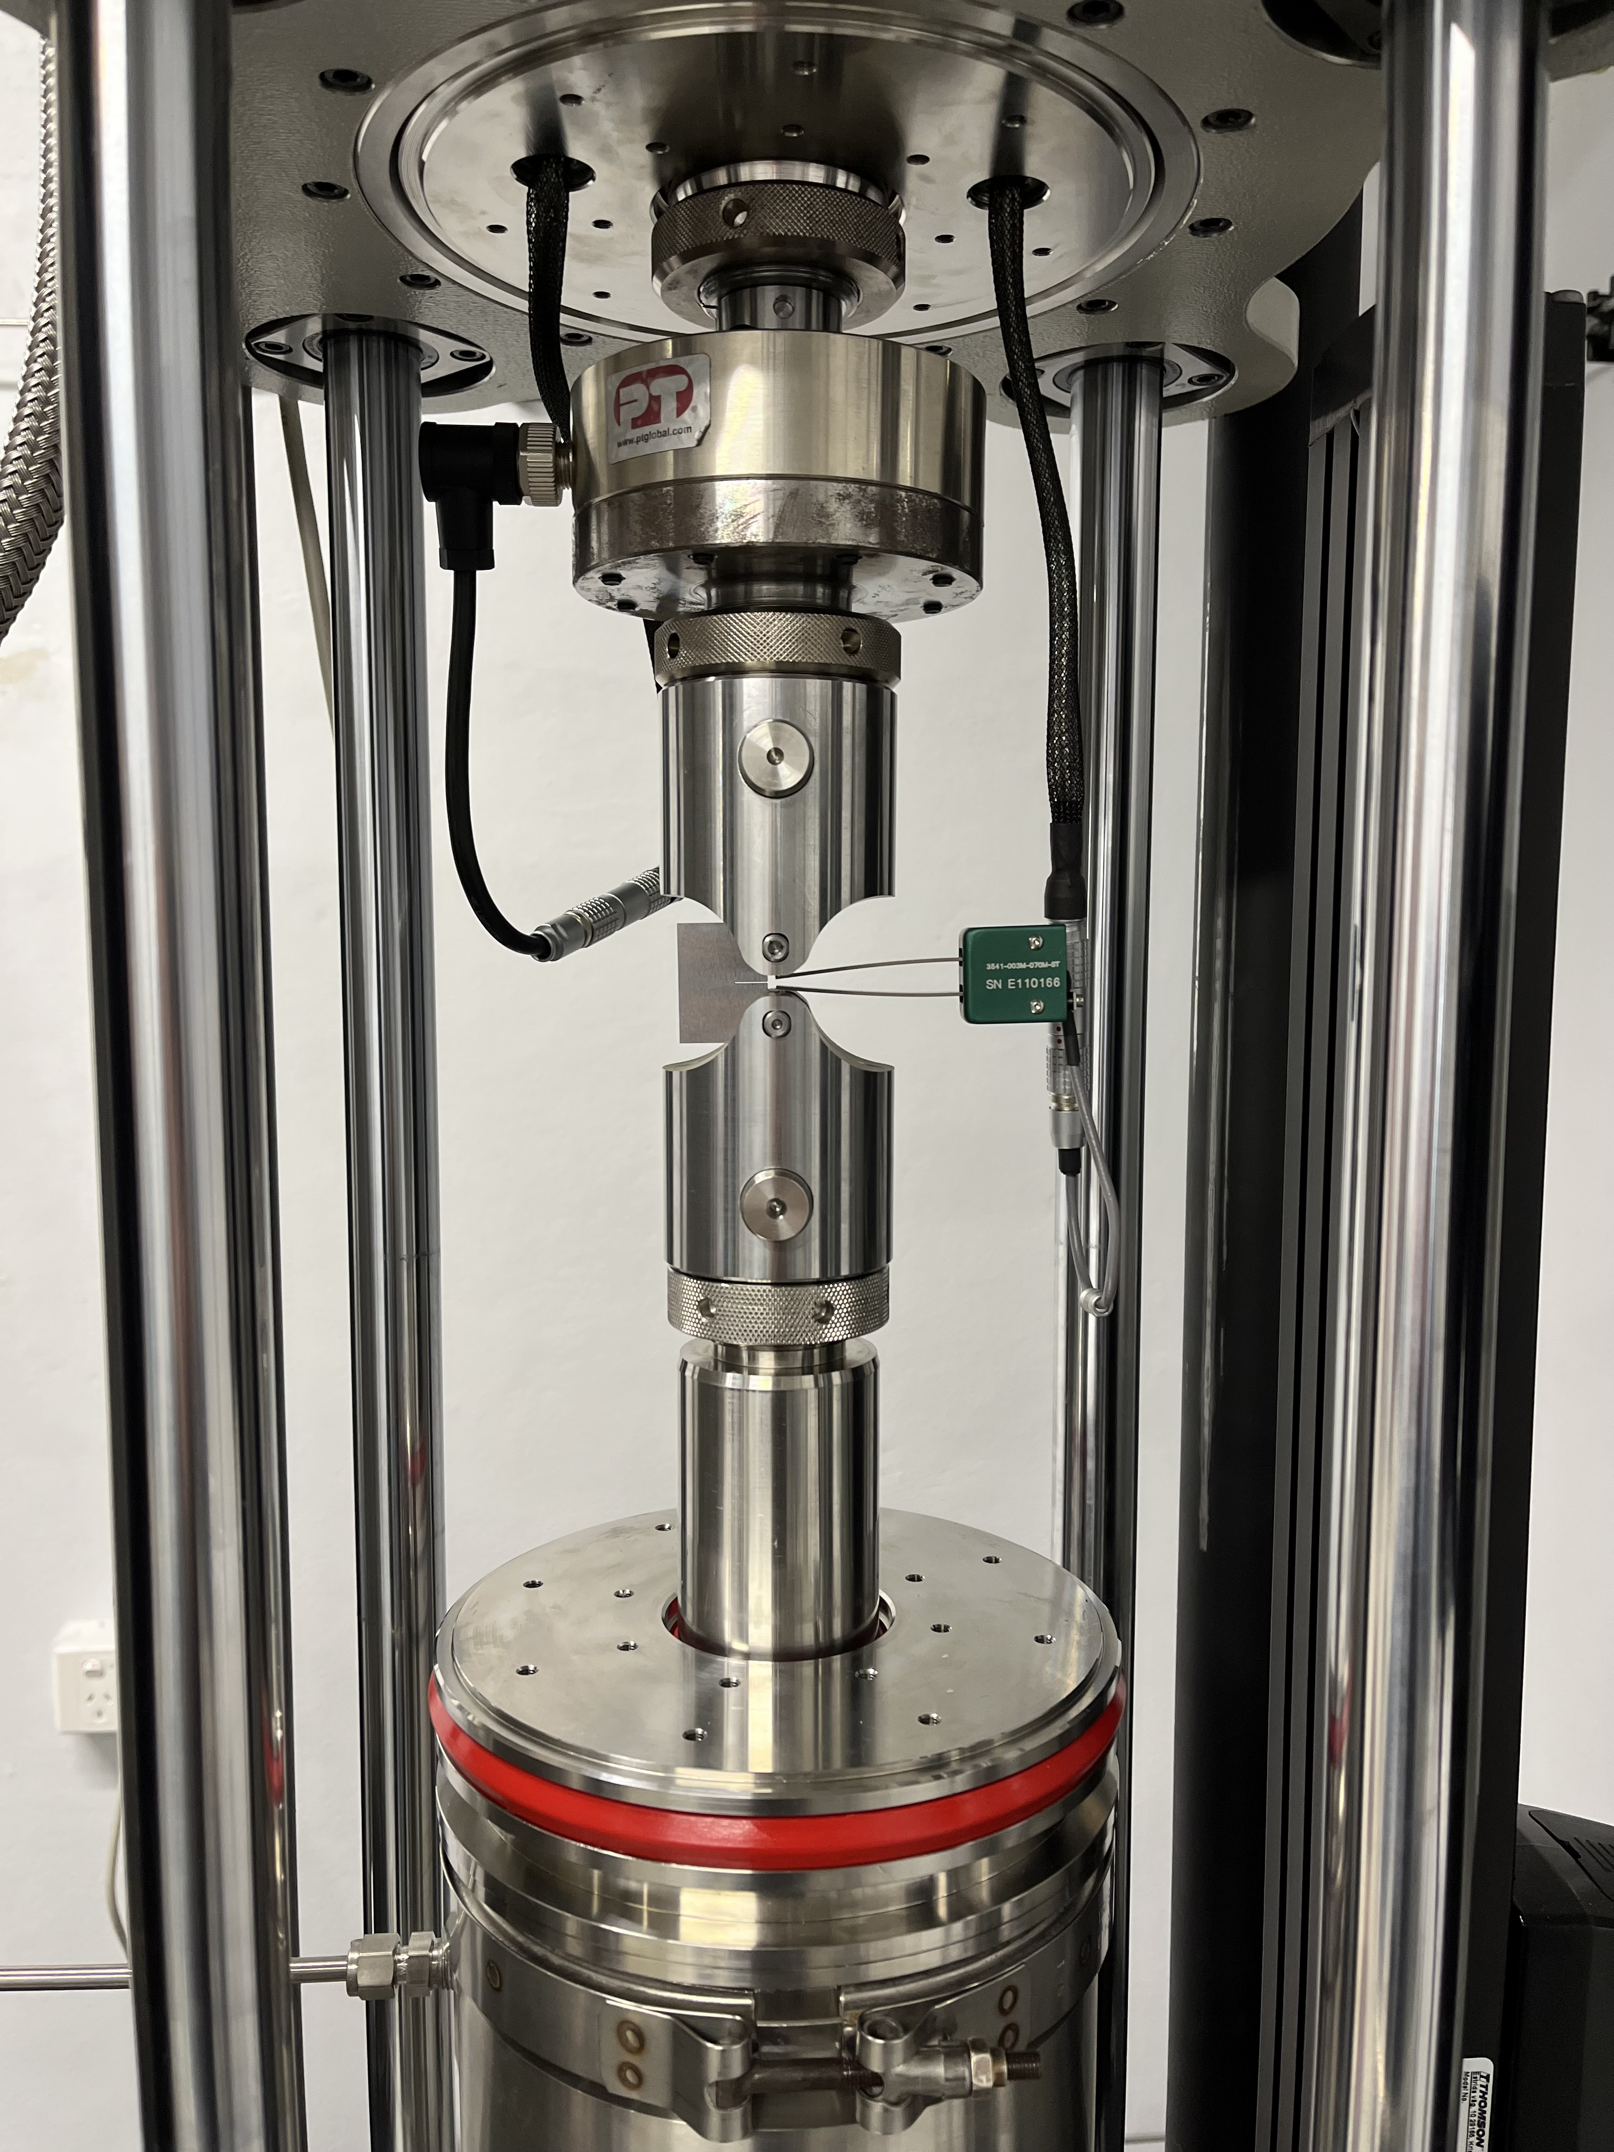

RP3.1-12 Gaseous H₂ testing of
representative Australian pipelines
Project purpose and scope
Builds up on RP3.1-09: Deployment of the H2SAFE(TI) Lab
An infrastructure with 3 gaseous H₂ testing
machines up to 500 kN load and 15 MPag
pressure, now operated by
Brings international testing know-how to Australia, capitalises expertise, involved with international laboratories in the developments of gaseous H₂ testing & standardisation
Assess material properties in air and hydrogen for 8 representative Australian line pipes and 1 sour service

Slide 4
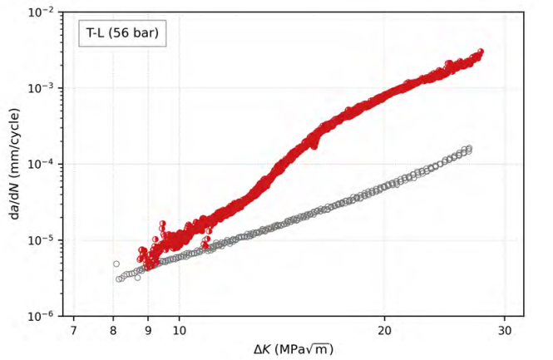
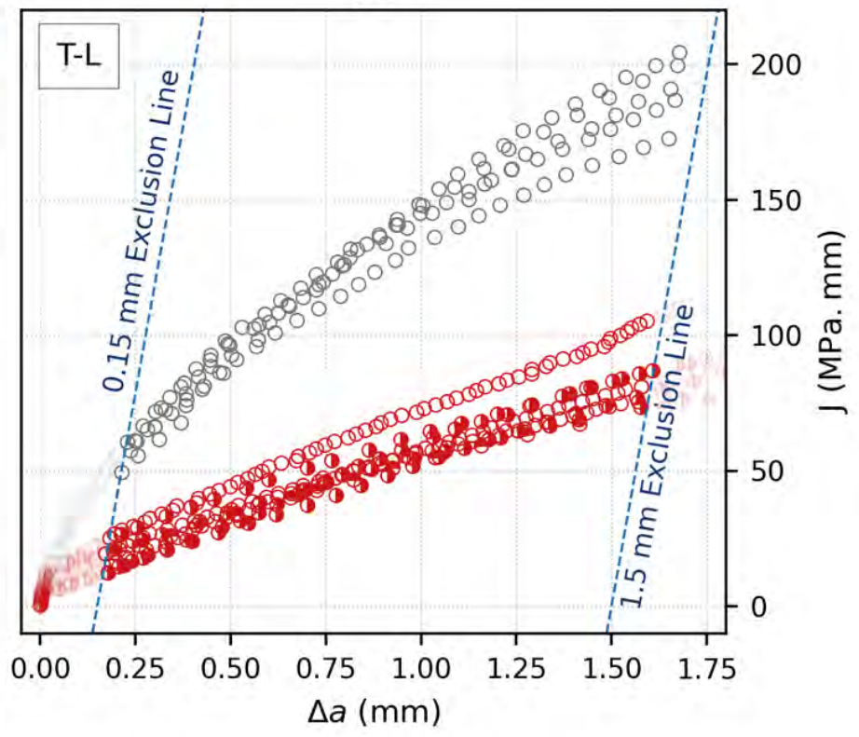
RP3.1-12 Gaseous H₂ testing of
representative Australian pipelines
Relevant knowledge gaps
KG.1. To what extent does the presence of hydrogen influence fatigue life and fracture resistance?
KG.2 How should fracture toughness or resistance be quantified?
KG.3 To what extent and over what ranges do impurities such as oxygen affect fatigue and fracture resistance?
KG.4 Does hydrogen influence the ductile-to-brittle transition temperature?

Slide 5
RP3.1-12 Gaseous H₂ testing of
representative Australian pipelines
Relevant knowledge gaps
KG.5 What role does strain rate play on the failure criterion of materials charged with hydrogen? Can this tell us something about a hydrogen pipeline’s susceptibility to running ductile fracture?
KG.6 What role does the charging method play (if any) on the results of hydrogen testing?
KG.7 Can hydrogen embrittlement testing be sped up?

Slide 6
RP3.1-12 Gaseous H₂ testing of
representative Australian pipelines
Relevant knowledge gaps
KG.8 How does hydrogen affect the failure assessment diagram?
KG.9 How significant is the discrepancy between internal and external defects with the presence of hydrogen?
KG.10 Does hydrogen affect the velocity of a running ductile fracture?

Slide 7
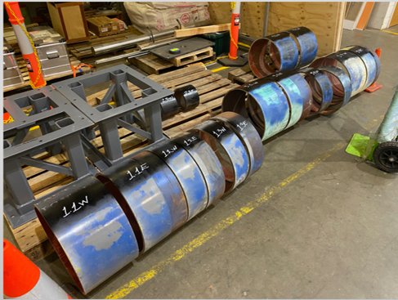
RP3.1-12 Gaseous H₂ testing of
representative Australian pipelines
Provided Line pipes
9 pipes for test program
Grades from X52 to X70
Years from 1980 to 2021
Test program:
Tensile test (Air, H2)
Fracture toughness (Air, H2)
Charpy tests (Air)
Base metal in transverse direction
Tests on similar material done at UQ with Electrochemical charging
Air characterisation delivered in previous
milestone

Slide 8
RP3.1-12 Gaseous H₂ testing of
representative Australian pipelines
Status of H₂ testing
Production of CT specimens available for all pipes
First batch of H₂ testing completed
Observed toughness higher than expected in H₂.
Behaviour not observed on material tested in a separate project
SEM observation of fracture faces indicate transition from ductile to H₂ embrittlement driven fracture process
Research process at play to understand ductile behaviour in first stage of the tests (impurities, test rate, oxide scales, test scheme
Current issue to be resolved prior to proceeding with remaining test program

Slide 9
RP3.2-06
Modern RDF control modelling

Slide 10
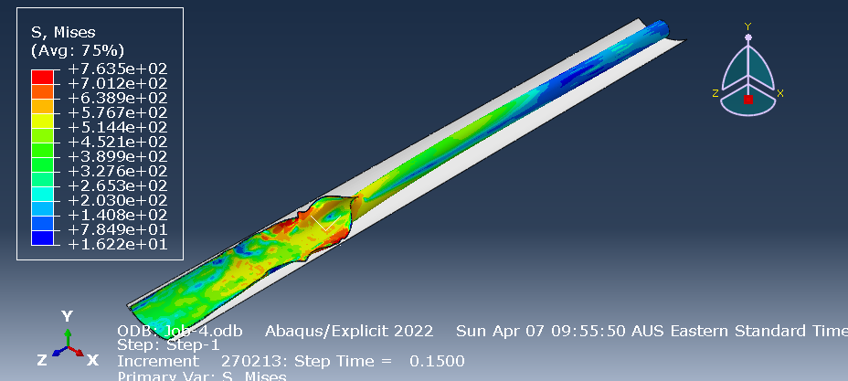
RP3.2-06 Modern RDF control modelling
Project purpose and scope
Cosham et al, IPC2014

Slide 11
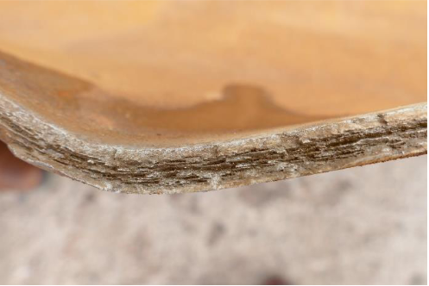
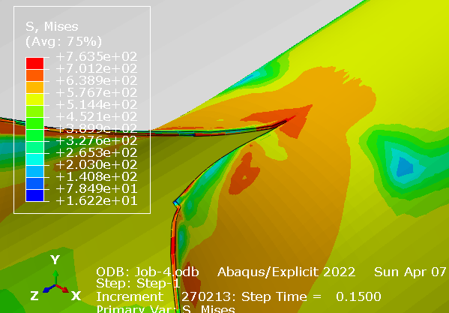
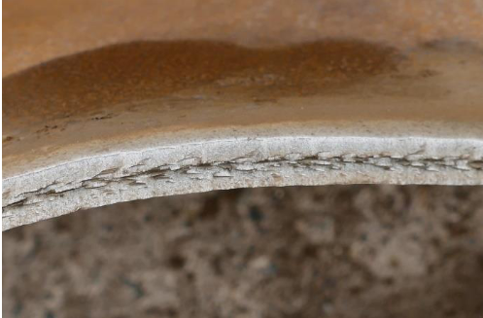
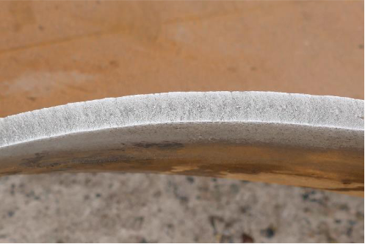
RP3.2-06 Modern RDF control modelling
Ductile failure modelling
Initiation pipe
Transition pipe
Arrest pipe

Slide 12
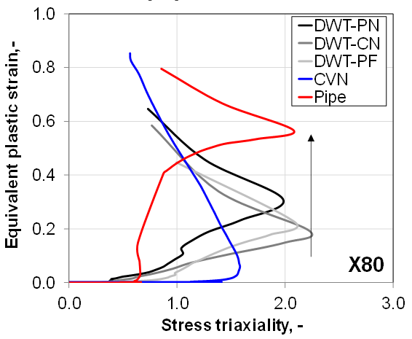
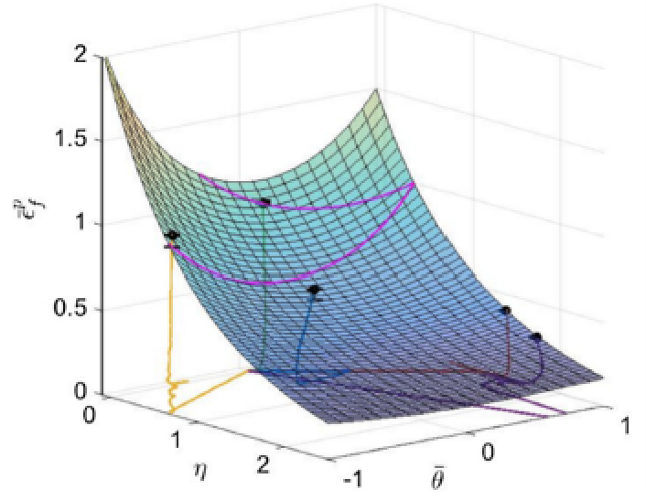
RP3.2-06 Modern RDF control modelling
Ductile Failure strain locus theories

Slide 13
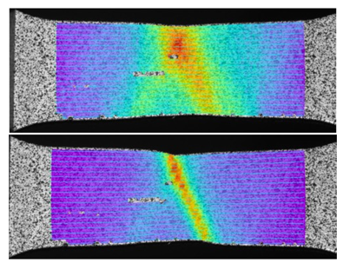
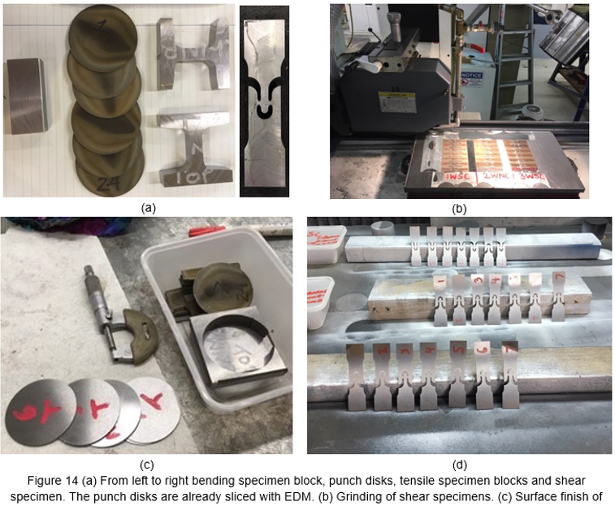
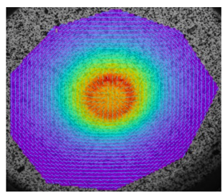
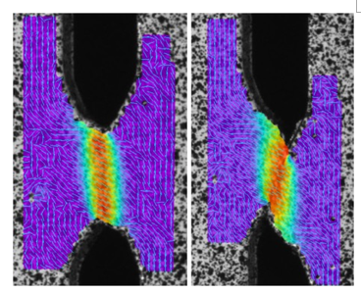
RP3.2-06 Modern RDF control modelling
Material characterisation & model calibration

Slide 14
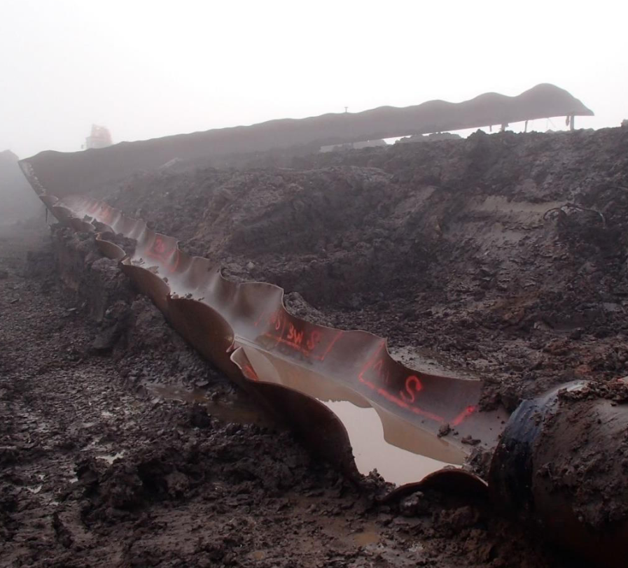
RP3.2-06 Modern RDF control modelling
Project outcomes
Leveraged FSPT data to explore modern ductile failure theories in the context of RDF control.
Lab-scale tests used to calibrate the failure locus-based fracture model. Need to extend triaxiality range of specimens.
Calibration based on DIC data gives reasonably good results.
High strain rate behaviour needs to be included.
February 2025 APGA/ FFCRC Webinar & project final report to learn more…

Slide 15
Related FFCRC Research Updates
Hydrogen Pipelines CoP Seminar – 6 March 2025
Doug Proud – FFCRC RP3 Coordinator (on behalf of Prof. Andrej Atrens)

Slide 16
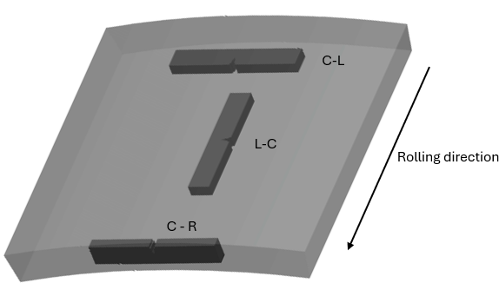
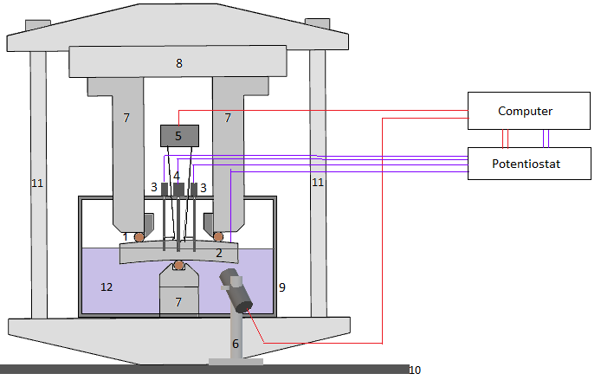
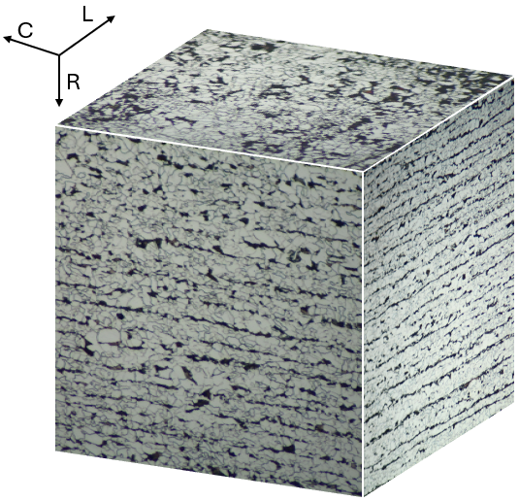
UQ hydrogen embrittlement studies
RP3.1-10 – X65 testing via electrochemical charging
Single-edge-notched bend specimens (SENB) for fracture toughness (“in-air” and “hydrogen-charged”)
Measured three orientations under various charging conditions (represents different hydrogen partial pressures)
Notes:
the

Slide 17
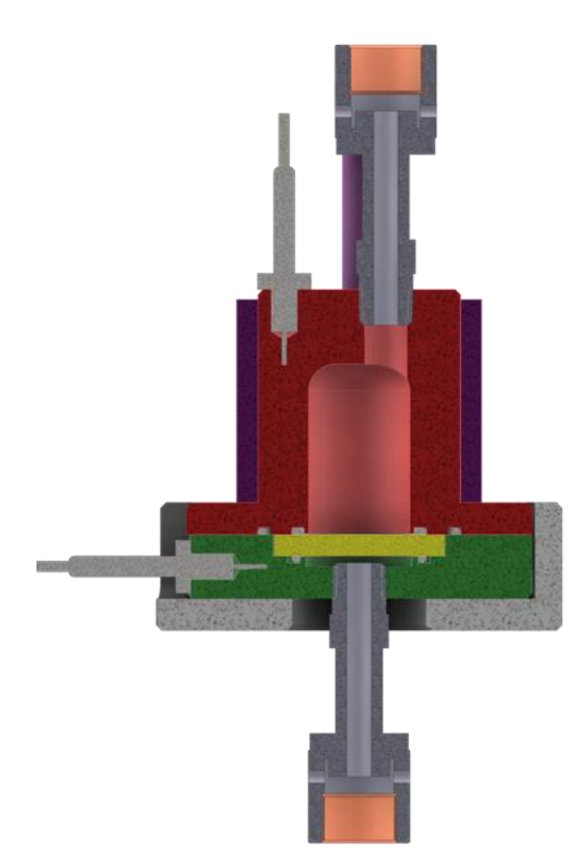
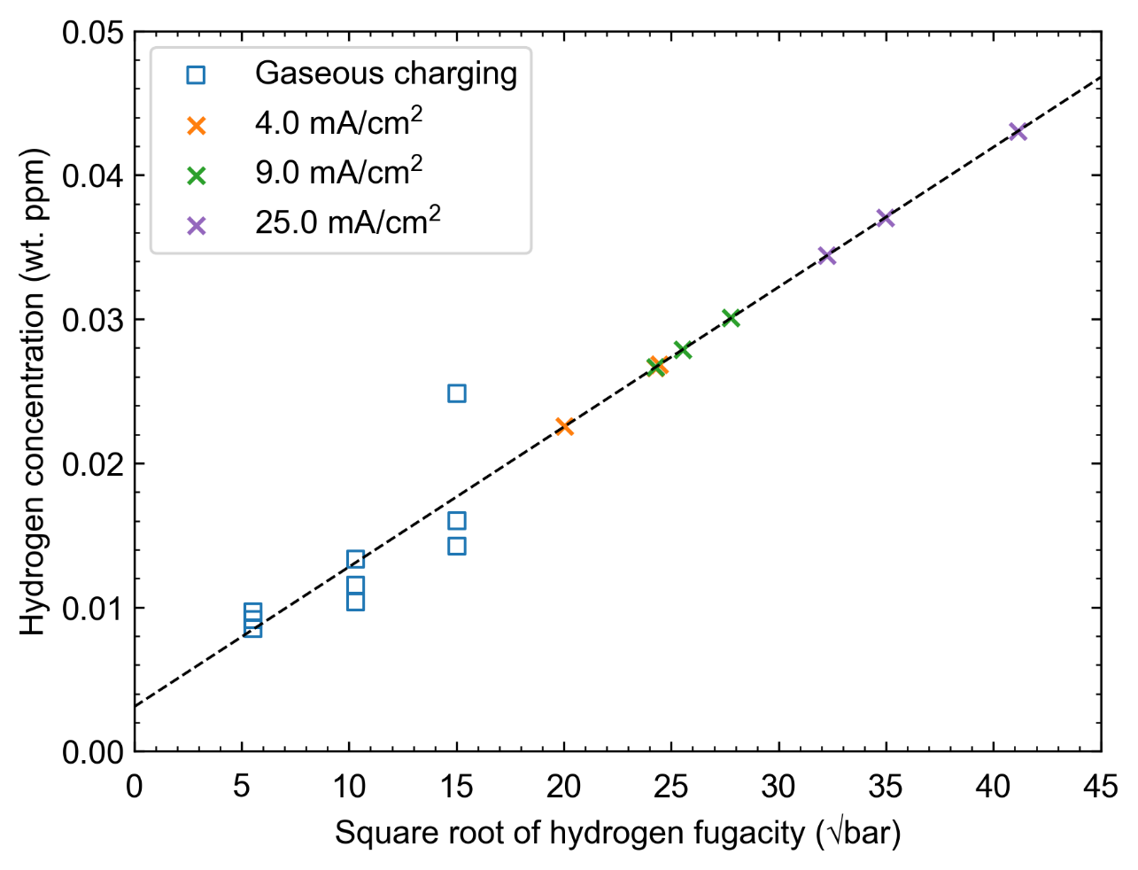
UQ hydrogen embrittlement studies
RP3.1-13 – Gas-phase permeation and O₂ inhibition
Experiments with gas-phase permeation cell:
  Measure hydrogen solubility in steel + diffusion coefficient (allows calibration of electrochemical charging)
  → In progress
  Study impacts of gas impurities such
  as O₂ (e.g. for inhibiting embrittlement)
  → To do (PhD student to continue
  post-CRC)
Notes:
the

Slide 18

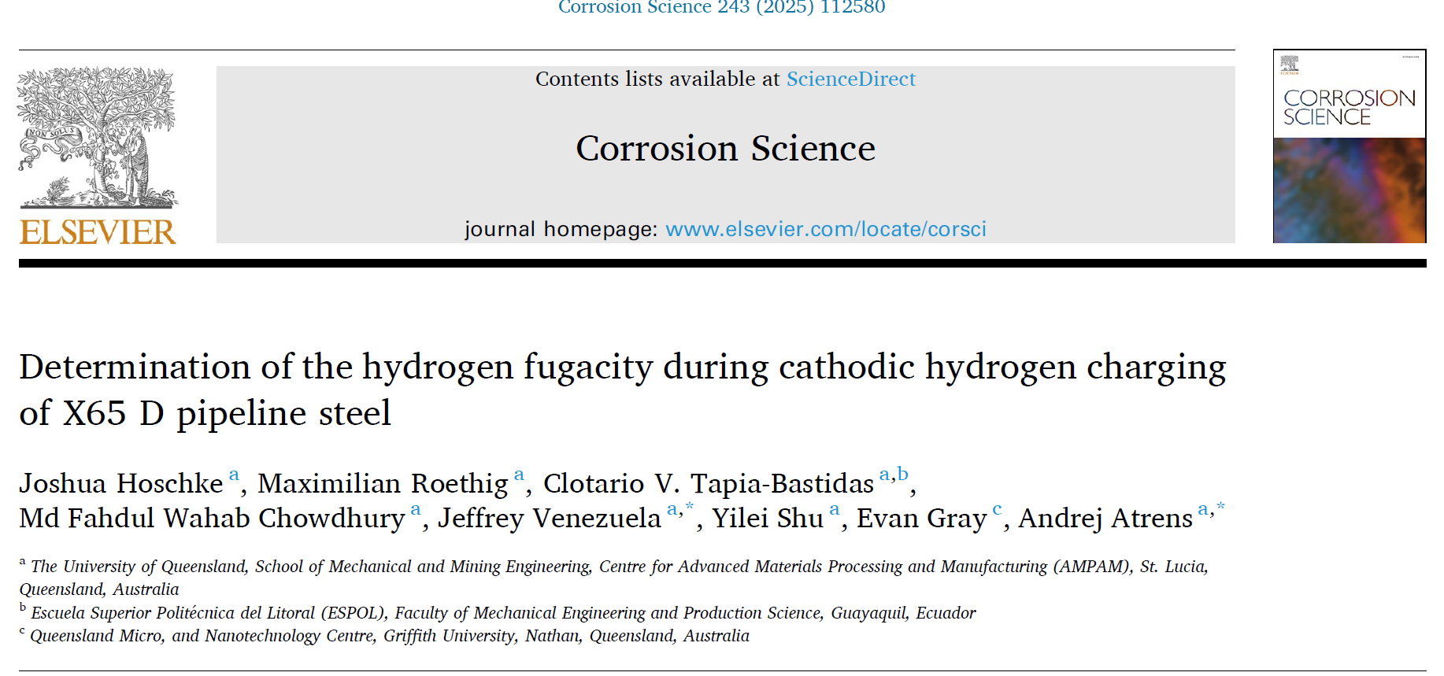
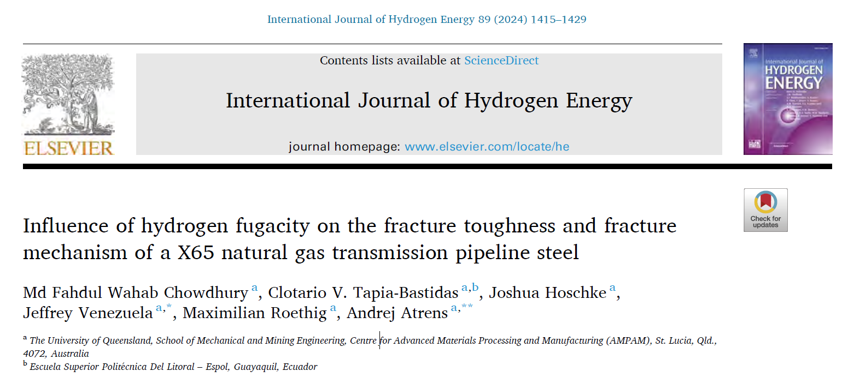
UQ hydrogen embrittlement studies
Recently published literature
  Influence of hydrogen fugacity on the fracture toughness and fracture mechanism of a X65 natural gas transmission pipeline steel
  Influence of hydrogen on the tensile properties of X65 D pipeline steel
  Determination of the hydrogen fugacity during cathodic hydrogen charging of X65 D pipeline steel
  A review of influence of hydrogen on fracture toughness and mechanical properties of gas transmission pipeline steels
Notes:
Let me know if access to pdf’s is required

Slide 19
UQ hydrogen embrittlement studies
Key findings and next steps
Impact of orientation (much higher toughness measured in C-R orientation)
Correlation of cathodic charging with gas-phase permeation
No sub-critical cracking observed
Recent tests performed to ensure loading rate is sufficiently slow
Comparison against UoW testing of same X65 steel is key!
Workshop to be held in two weeks time to compare, review and disseminate results
Notes:
the

Slide 20
Overview of relevant research
(RP3.1-12)
(RP3.1-06)
(RP3.1-10)
(RP3.1-13)
(RP3.2-02)
(RP3.2-06 & RP3.10-03)
(RP3.1-02)
(RP3.4-08)
(RP3.4-01)
(RP3.2-12)
UoW SAFE(TI) lab
Materials testing of pipeline steels in gaseous hydrogen
Hydrogen permeation through the pipe wall
UQ HE studies
Materials testing of pipeline steels via cathodic charging
Gas-phase permeation and O2-inhibition of HE
Other UoW research
Shock-tube/decompression testing of H2/NG mixtures
Failure-strain locus model (“ABC”) assessment/development
Other projects (not covered)
Hydrogen interaction with steels via APT
Hydrogen interaction with external pipeline coatings
Internal coatings to prevent/inhibit hydrogen embrittlement
Understanding H2/NG mixing and stratification
Notes:
the

