Slide 1
Gabriel Pizani B.Eng MIEAust CPEng
Joe Short
Pipelines Manager – Verbrec
Principal Integrity Engineer – ROSEN UK
Asset integrity engineer with 20 years of experience, mainly in the pipeline specialty through technical and strategic application of integrity management principles, methods and technologies.
Gabriel has proven success in senior technical and leadership positions in Australia and internationally, with his experience including roles with pipeline operators, industry service providers and consulting firms.
Gabriel currently leads the Pipelines Discipline for Verbrec, based in Brisbane, responsible for delivery of projects covering the entire pipeline life-cycle for clients in Australasia. He continues to technically lead and support integrity related projects and developing Pipeline Management Systems whilst mentoring his team in the specialty. He also supports Verbrec’s Competency Training business as an instructor on the AS2885.3 (Operations and Maintenance) training course.
Gabriel has been an active and dedicated member of the ME-038-03 Committee since 2006.
Joe is a Principal Engineer with 15 years of global experience in pipeline integrity management consultancy, with a particular focus on pipeline anomaly assessments, post-in-line inspection (ILI) integrity engineering, and integrity management procedures and planning.
In his current role provides dedicated subject matter expert (SME) technical guidance and leadership for pipeline integrity work conducted by ROSEN in the Asia Pacific region, and SME responsibilities for anomaly assessment within NIMA, ROSEN’s digital Asset Integrity Management Software platform. Joe has extensive experience in fitness for purpose (FFP) assessment methodologies, ILI technologies, best practice in ILI comparison, and excellent knowledge of international code guidance in pipeline integrity management.
Joe provides online and in-person training courses on best practice in pipeline anomaly assessment methodologies, as part of ROSEN’s Education Systems & Services business line.
Joe has been a member of the ME-083-03 Committee since 2016.

Slide 2
AS 2885.3 Seminar
Section 9
Joe Short – ROSEN UK
Gabriel Pizani - Verbrec

Slide 3
Section 9 – Basis of Section & Guiding Principles
Clause 9.1
“This Section of the standard details the minimum requirements for the management of pipe wall ANOMALIES and includes an assessment process to determine whether they are DEFECTS and, if applicable, repair strategies and techniques.”
Essentially – once you find an anomaly, what do you do?
Guiding Principles:
Provision of some minimum requirements, but not wholly prescriptive.

Slide 4
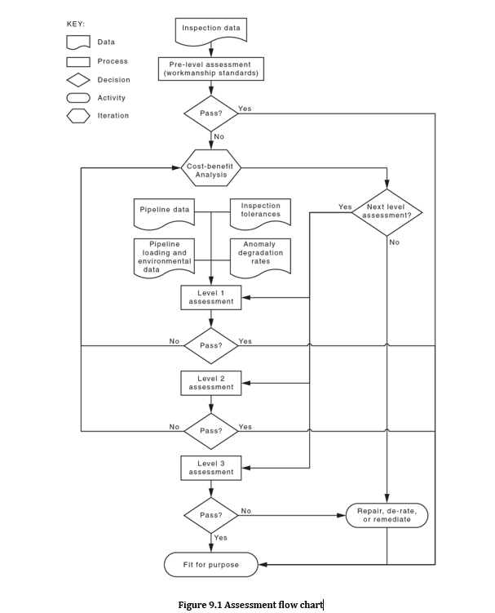
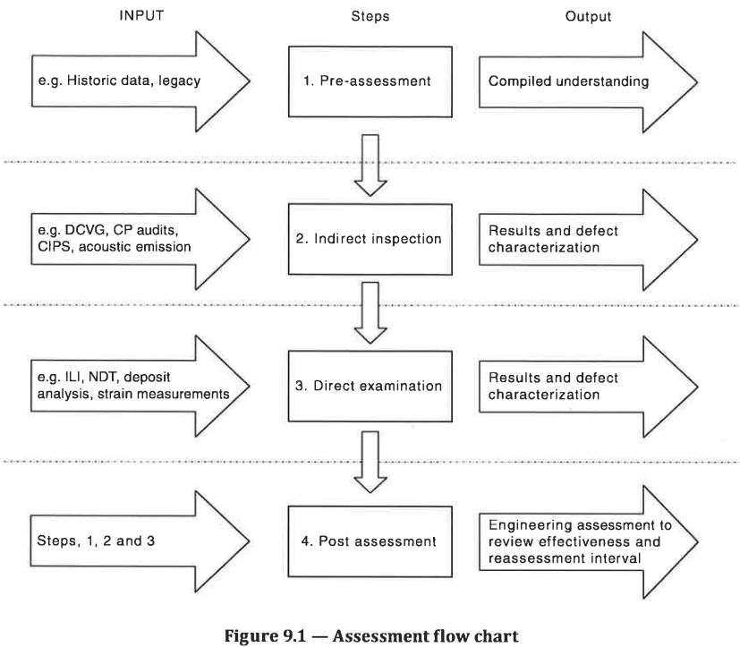
Key changes to Section 9
Content Moved:
Direct Assessment, moved to Section 6
Improved Guidance:
Anomaly assessment (9.3): assessment process, safety factors and assessment methods
Repair guidance (9.4): repair methods, repair process and repair plan
Anomaly Management and Initial Response – Pressure Restriction:
Improved clarity for pressure restrictions as an initial response to an unsafe situation (temporary pressure limit vs. ROP)

Slide 5
Section 9 – Initial Assessment & Response
Clause 9.2 “Anomaly Management – Initial Assessment and Response”
Where PIPELINE SYSTEM integrity may be compromised, immediate steps shall be taken to maintain continued safe operation
“Temporary Pressure Limit” to be determined, based on assessment results (where possible), likely failure mode
Short term measure to minimise risk of failure
Longer term pressure restrictions require ROP
Must be documented and managed, including formal advice to the relevant control room.
Moved to start of section to reflect chronology (previously in repair sections)

Slide 6
Section 9 – Anomaly Assessment: Key Points
Assessment Process:
Guidance on key inputs and outputs (9.3.2, 9.3.4)
Levels of assessment (1,2,3)
Safety Factor (Clause 9.3.2.3):
Typical inverse of design factor (e.g. 1/0.72 = 1.39)
Introduction of minimum SF of 1.25
Brought in-line with industry guidance (i.e. SF >1)
Anomaly Assessment Themes:
Assessment of all anomalies required
Now mandatory to calculate remaining lives for anomalies subject to time-dependent degradation (9.3.2.4), a key anomaly assessment output (9.3.4)
Emphasis on assessing all applicable loads
Anomaly assessment methods / guidance:
New methods added
Table B1 is not prescriptive!
Signposts to comprehensive guidance (e.g. API RP 1176)

Slide 7
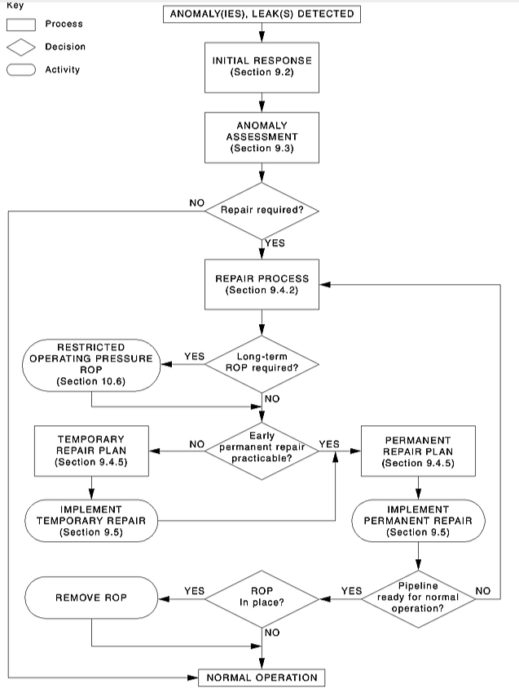
Repair Strategy (Clause 9.4)
Improved Repair Strategy Flowchart and guidance
ROP incorporated as key part of the Repair Process
Temporary Repairs as a ‘pathway’ to a Permanent Repair
Quick Clause references
Repair Process (9.4.2)
Temporary and Permanent Repairs (9.4.3, 9.4.4)
Repair Plan (9.4.5)

