Slide 1
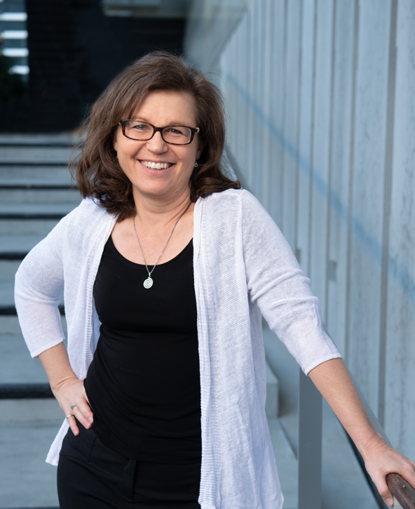
Susan Jaques
Susan is an industry leader in understanding and communicating standardisation in the infrastructure industry. Originally from Canada where she obtained her civil engineering degree, she has lived in Brisbane for over 25 years.
With a background in industrial infrastructure projects, she helps professionals develop leadership excellence through reliable management of risk, quality, competence, and knowledge. She believes that standards, both personal or technical, build strength.
At the 2023 APGA conference, Susan was presented with the Outstanding Contribution award, for service to the industry for a sustained period of time. This follows previously receiving the 2004 Young Achievement award, for valued an innovative contribution to the Australian pipeline industry.
Sage Consulting Solutions Pty Ltd

Slide 2
AS 2885.3 Seminar
AS2885 Overview
Presented By Susan Jaques

Slide 3
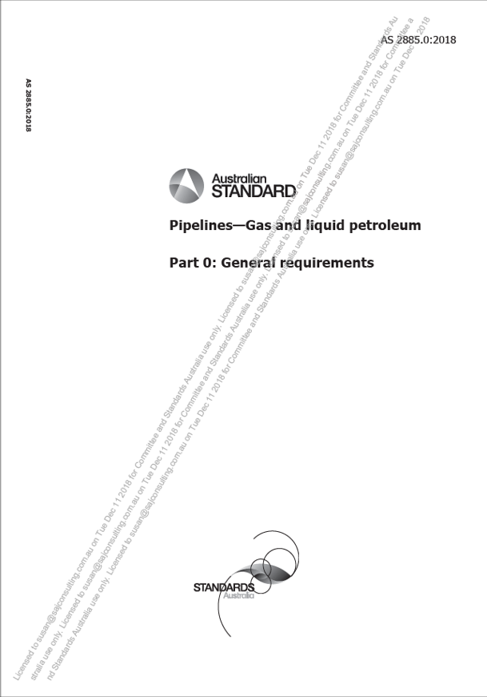
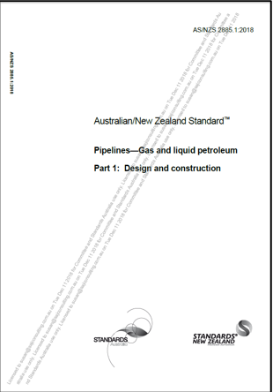
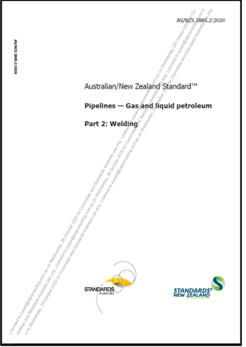
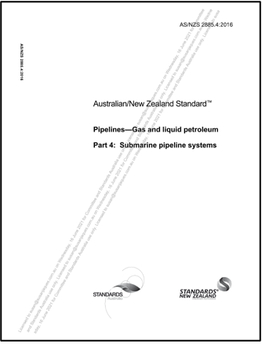
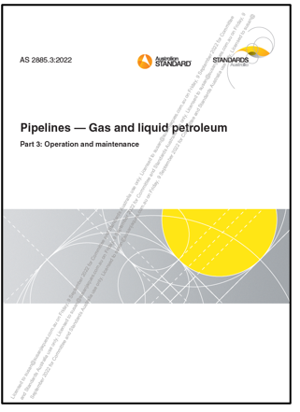
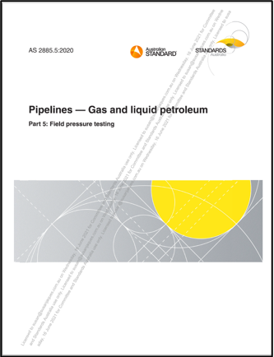
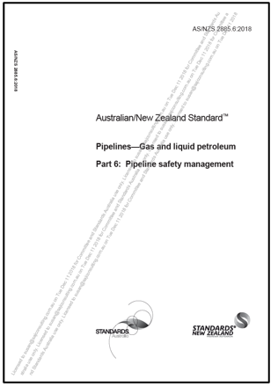
AS2885: Pipelines in 7 Parts
2885.0 General Requirements
2885.1 Design and Construction
2885.2 Welding
2885.3 Operations and Maintenance
2885.4 Subsea Pipelines
2885.5 Field Pressure Testing
2885.6 Pipeline Safety Management

Slide 4
Key Themes
The suite is a whole suite, not parts.
Pipelines must be operated as designed.
We’re retrospective here in Part 3.
Approvals must be sought, sometimes.
Standards users should know shalls.
There are Defined Terms to abide by.
Changes are outlined in the preface, and -
Revisions aren’t just for the fun of it.

