Slide 1
Stirling Mawby Nunukul-Ngugi Tribe Quandamooka
Director and Owner of Bajara Plant Hire
Bajara (Ba-ja-rra), meaning “footprint” Jandai language of the Noonukul Tribe on North Stradbroke Island.

Slide 2
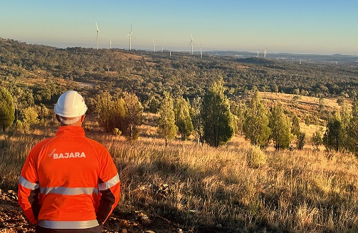
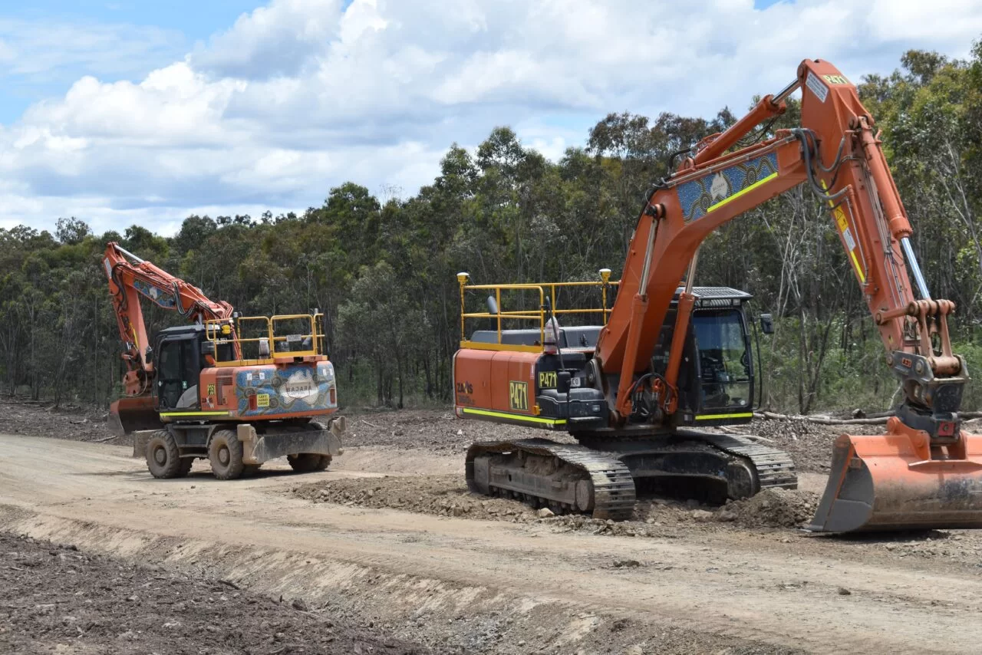
www.bajara.com.au

Slide 3
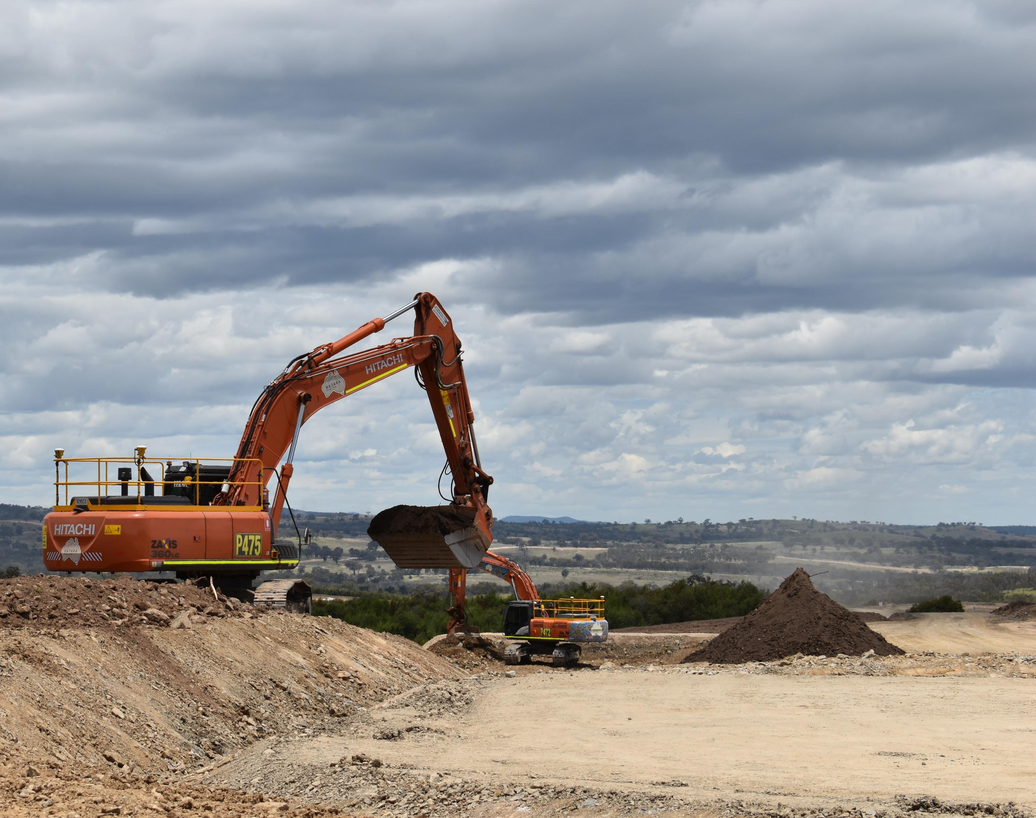
The Challenges and Accomplishments What are the challenges that Bajara has faced within the industry? Procurement and Capability Challenges Employment Internal staff issues Project challenges Accomplishments Growth (employment and assets) Capabilities Project portfolio Client relationships Engaging Indigenous businesses Infrastructure and Capabilities Audience questions www.bajara.com.au

